Slide 1
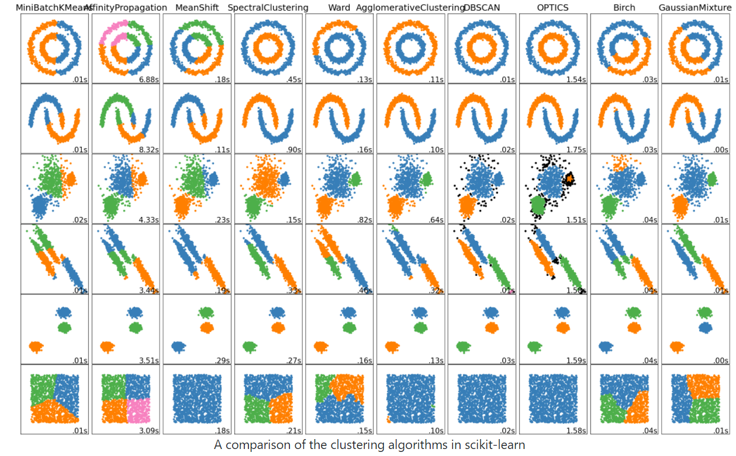
Cheet sheet

Slide 2
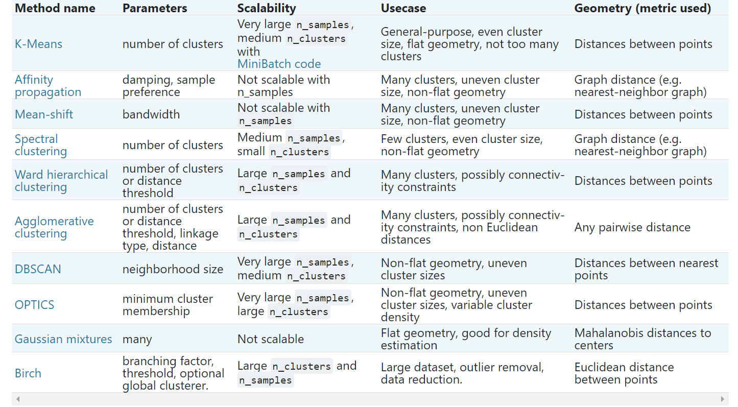
Cheet sheet

Slide 3
kmeans
https://scikit-learn.org/stable/modules/clustering.html#k-means
Mini-batch kmeans
Notice that if you have too many samples, use mini-batch kmeans to accelerate the clustering process

Slide 4
Affinity Propagation
Affinity Propagation was first published in 2007 by Brendan Frey and Delbert Dueck in Science. In contrast to other traditional clustering methods, Affinity Propagation does not require you to specify the number of clusters. In layman’s terms, in Affinity Propagation, each data point sends messages to all other points informing its targets of each target’s relative attractiveness to the sender. Each target then responds to all senders with a reply informing each sender of its availability to associate with the sender, given the attractiveness of the messages that it has received from all other senders. Senders reply to the targets with messages informing each target of the target’s revised relative attractiveness to the sender, given the availability messages it has received from all targets. The message-passing procedure proceeds until a consensus is reached. Once the sender is associated with one of its targets, that target becomes the point’s exemplar. All points with the same exemplar are placed in the same cluster.
The algorithm will converge around a small number of clusters if a smaller value is chosen for the diagonal, and vice versa.
注意这里的‘preference‘ 是对应接口需要设置的参数，也可以使用模型，参数越大，聚类的类别越多
responsibility : 我很优秀，选我吧
availability : 我比较一下，看看你在所有人当中的水平如何

Slide 5
Affinity Propagation
The algorithm has a time complexity of the order O(N2T), where N is the number of samples and T is the number of iterations until convergence. Further, the memory complexity is of the order O(N2) if a dense similarity matrix is used, but reducible if a sparse similarity matrix is used. This makes Affinity Propagation most appropriate for small to medium sized datasets.
时间复杂度高
https://towardsdatascience.com/unsupervised-machine-learning-affinity-propagation-algorithm-explained-d1fef85f22c8
https://aneesha.medium.com/using-affinity-propagation-to-find-the-number-of-clusters-in-a-dataset-52f5dd3b0760

Slide 6
Mean - shift
To explain mean-shift we will consider a set of points in two-dimensional space like the above illustration. We begin with a circular sliding window centered at a point C (randomly selected) and having radius r as the kernel. Mean shift is a hill-climbing algorithm that involves shifting this kernel iteratively to a higher density region on each step until convergence.
https://towardsdatascience.com/the-5-clustering-algorithms-data-scientists-need-to-know-a36d136ef68
The algorithm automatically sets the number of clusters, instead of relying on a parameter bandwidth, which dictates the size of the region to search through. This parameter can be set manually, but can be estimated using the provided estimate_bandwidth function, which is called if the bandwidth is not set.
可以自动确定聚类的数量
Bandwidth 控制搜索范围，可以默认使用skelarn自动估计范围的函数
The algorithm is not highly scalable, as it requires multiple nearest neighbor searches during the execution of the algorithm. The algorithm is guaranteed to converge, however the algorithm will stop iterating when the change in centroids is small. It has a time complexity of O(n(squared)), where n is the number of data points.
时间复杂度高
https://scikit-learn.org/stable/modules/clustering.html#mean-shift

Slide 7
Mean - shift
Gif : 演示状态可显示mean-shift过程

Slide 8
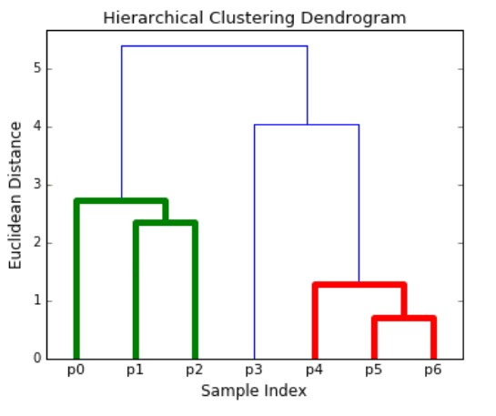
Hierarchical clustering
The AgglomerativeClustering object performs a hierarchical clustering using a bottom up approach: each observation starts in its own cluster, and clusters are successively merged together. The linkage criteria determines the metric used for the merge strategy:
Ward minimizes the sum of squared differences within all clusters. It is a variance-minimizing approach and in this sense is similar to the k-means objective function but tackled with an agglomerative hierarchical approach.
Maximum or complete linkage minimizes the maximum distance between observations of pairs of clusters.
Average linkage minimizes the average of the distances between all observations of pairs of clusters.
Single linkage minimizes the distance between the closest observations of pairs of clusters.
以上四种方式提供了四种group之间的合并方式。
These advantages of hierarchical clustering come at the cost of lower efficiency, as it has a time complexity of O(n³), unlike the linear complexity of K-Means and GMM.
时间复杂度高
https://towardsdatascience.com/the-5-clustering-algorithms-data-scientists-need-to-know-a36d136ef68
https://scikit-learn.org/stable/modules/clustering.html#hierarchical-clustering

Slide 9
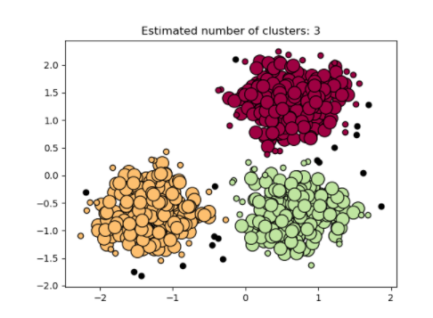
DBSCAN
The DBSCAN algorithm views clusters as areas of high density separated by areas of low density. Due to this rather generic view, clusters found by DBSCAN can be any shape, as opposed to k-means which assumes that clusters are convex shaped. The central component to the DBSCAN is the concept of core samples, which are samples that are in areas of high density. A cluster is therefore a set of core samples, each close to each other (measured by some distance measure) and a set of non-core samples that are close to a core sample (but are not themselves core samples). There are two parameters to the algorithm, min_samples and eps, which define formally what we mean when we say dense. Higher min_samples or lower eps indicate higher density necessary to form a cluster.
DBSCAN has a worst-case of O(n²),

Slide 10
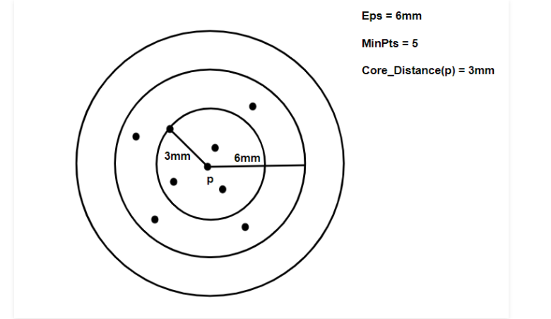
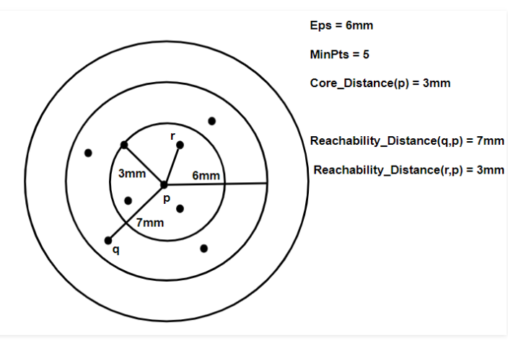
OPTICS
Optics produces a visualization of Reachability distances and uses this visualization to cluster the data.
Core Distance: It is the minimum value of radius required to classify a given point as a core point. If the given point is not a Core point, then it’s Core Distance is undefined.
Reachability Distance: It is defined with respect to another data point q(Let). The Reachability distance between a point p and q is the maximum of the Core Distance of p and the Euclidean Distance(or some other distance metric) between p and q. Note that The Reachability Distance is not defined if q is not a Core point.
https://www.geeksforgeeks.org/ml-optics-clustering-explanation/#:~:text=OPTICS%20Clustering%20stands%20for%20Ordering,point%20as%20a%20core%20point.

Slide 11
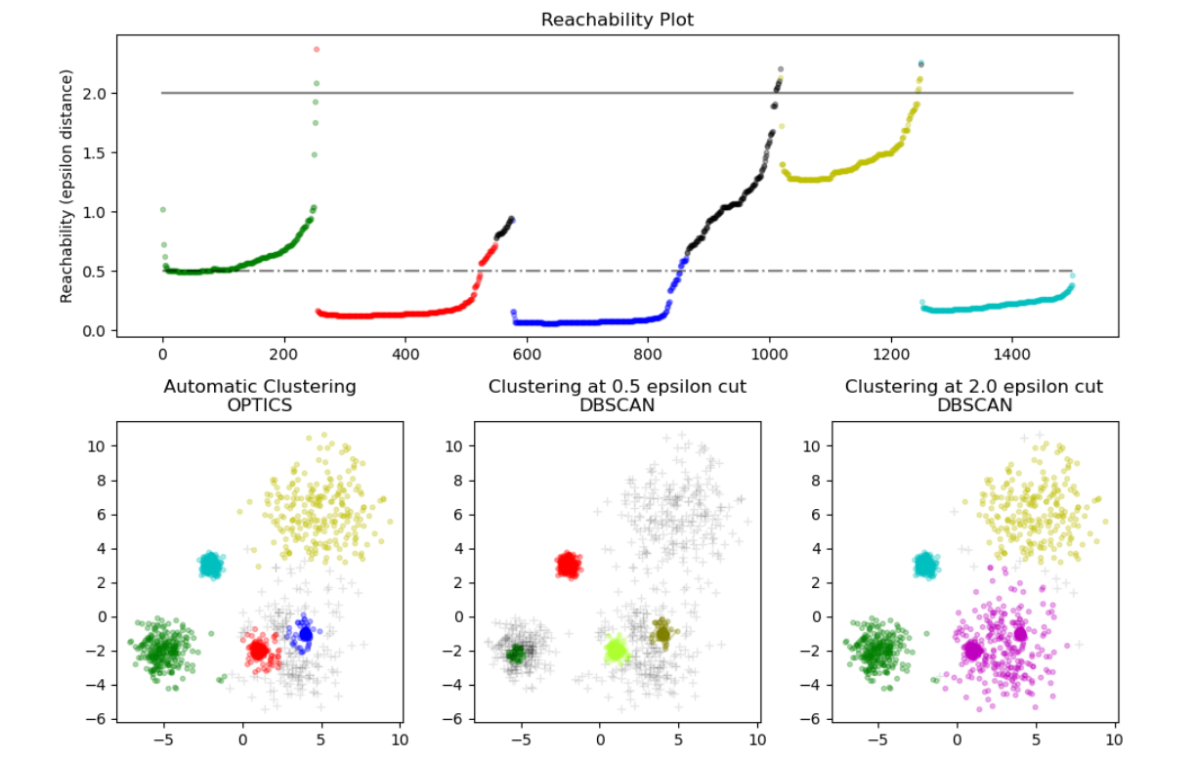
OPTICS
This technique does not segregate the given data into clusters. It merely produces a Reachability distance plot and it is upon the interpretation of the programmer to cluster the points accordingly.
Sklearn implementation:
Note that we do not employ a heap to manage the expansion candidates, so the time complexity will be O(n^2).

Slide 12
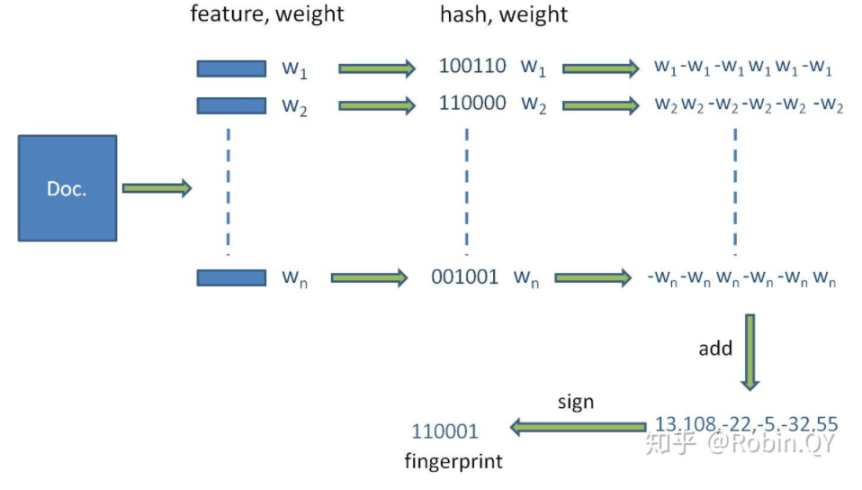
Simhash
Often used for removing duplicated documents, the algorithm process is as below:
对文本分词，得到N维特征向量（默认为64维）
为分词设置权重（tf-idf）
为特征向量计算哈希
对所有特征向量加权，累加（目前仅进行非加权累加）
对累加结果，大于零置一，小于零置零
得到文本指纹（fingerprint）
notice we use hamming distance to evaluate simhash similarity
https://zhuanlan.zhihu.com/p/71488127

